Slide 1


A Climatological Analysis of Convection in the Trentino Region of the Italian Alps
Jackson Macfarlane, Greta Graeler, Curtis James
Embry-Riddle Aeronautical University
Arizona Space Grant Symposium, April 23rd, 2022

Slide 2
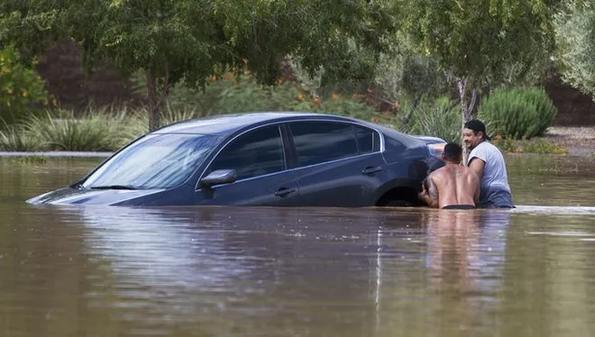
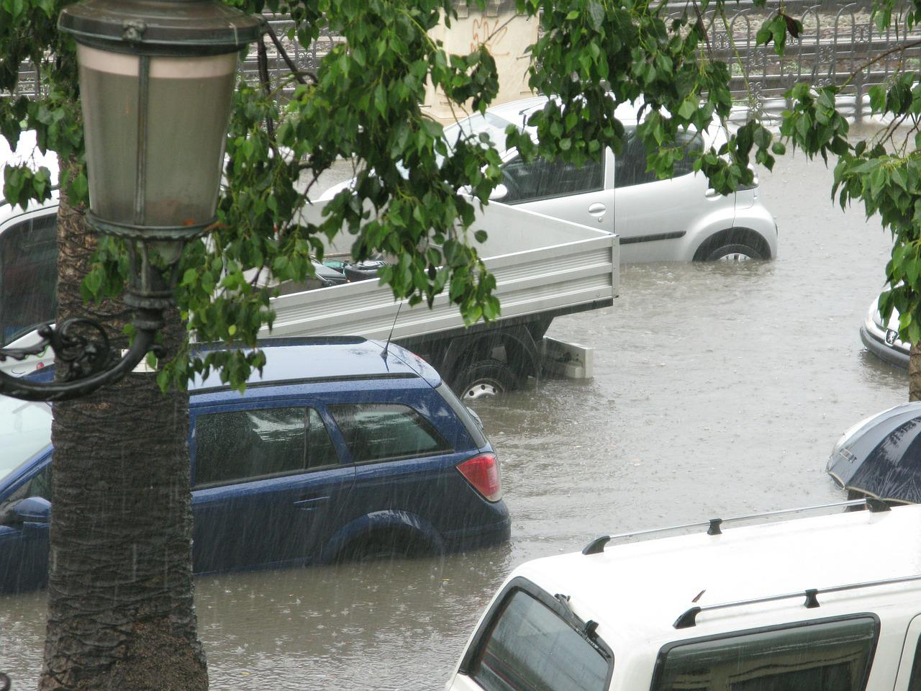

Problem and Objectives
Severe convection and flash flooding events are common in the European Alps as in many mountainous climates, causing property damage and loss of life.
Map storms in the Italian Alps using radar data.
Source: Michael Chow/The Republic
Source: WikiImages
Notes:
Our study uses an algorithm that analyzes radar data from the TAASRAD19 dataset to identify thunderstorm cells across an xy plane over 9 years. Using the thunderstorm tracks produced we will:
Identify where thunderstorms are most frequent in the Italian Alps.
Identify regions of enhanced thunderstorm initiation.
Analyze thunderstorm propagation and atmospheric predictors.

Slide 3
Data Handling (3 Phases)
Data Acquisition
  The TAASRAD19 dataset
  Integration
  Remove erroneous data
  Check data units
  Importing data
  Producing storm tracks
Data Verification
Data Analysis

Slide 4
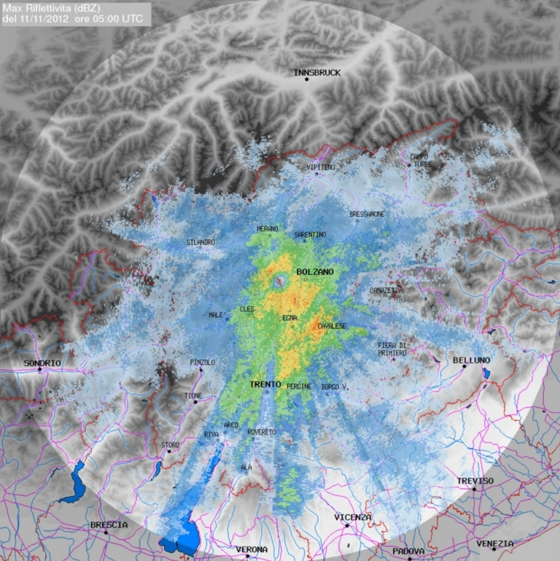
Data Acquisition
Decibels of Reflectivity (dBZ) Plotted
TAASRAD19 Dataset
  900,000 timesteps over 9 years
  Covers a 240km diameter
Integration
Y
(500m)
Time
(5 minutes)
X
(500m)
Source: Franch et al. 2020
Notes:
TAASRAD19 Dataset
Around 900,000 timesteps over 9 years containing reflectivity data acquired by Trentino South Tyrol Region Civil Protection.
Covers a 240km diameter
NETCDF Data Format
Only days with precipitation are considered
Integration
Importance of file organization
How the NetCDF files are read into python

Slide 5
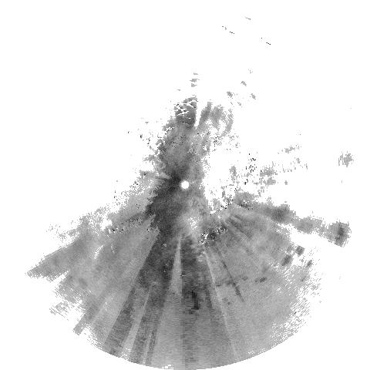

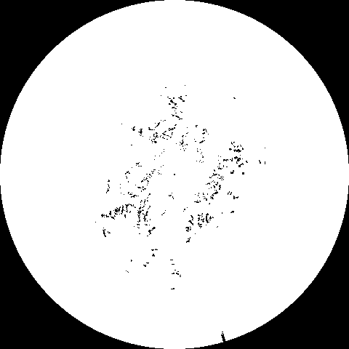
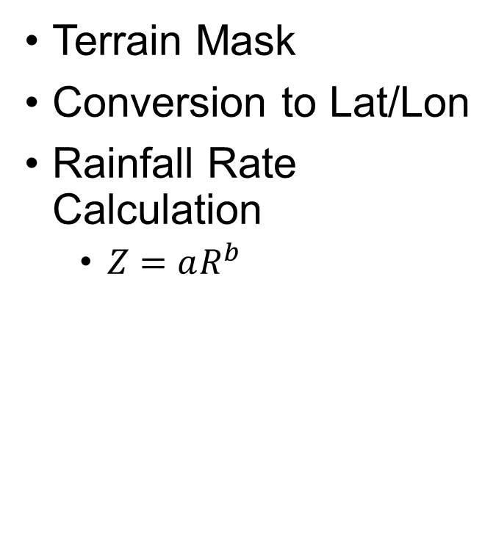
Data Quality
Terrain Mask
Conversion to Lat/Lon
Rainfall Rate Calculation
  $Z=aR^{b}$
Source: Franch et al. 2020
Notes:
Terrain Mask
Using a mask developed by the TAASRAD19 team, pixels heavily correlated to terrain clutter are masked out.
Conversion to Lat/Lon
To ensure the algorithm can understand the distances between identified cells.
Rainfall Rate
A = 200
B = 1.4

Slide 6
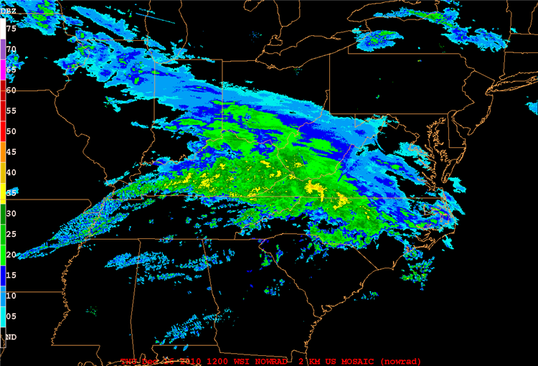
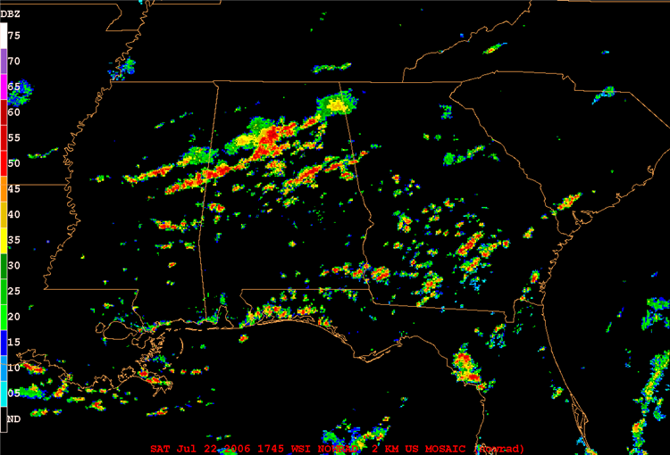
Data Analysis
Algorithm
  Importing Data
  Producing Storm Tracks
Source: Penn State
Dept. of Meteorology and Atmospheric Science
Notes:
Algorithm
The algorithm was not originally made for this dataset, therefore a new data importer had to be created.
The importer allows the algorithm to understand the xy distances and timesteps to correctly identify the same cell across multiple timesteps.
A cell area and reflectivity threshold filter out non-convective cells.

Slide 7
Expected Results
Correlating cells across timesteps
Density maps
Source: James et al. 2022
Source: Adler et al. 2015
Notes:
The importer is still having trouble correlating the same cell across multiple timesteps.
Cell density maps can be plotted, but all 9 years of data must be tracked first.

Slide 8
Future Directions
Plot initiation frequency, time, and area.
Use predictors
  Windshear, wind direction and speed, and instability.
Identify why, where, and when storms are more likely.
Notes:
Once the algorithm can correctly correlate the same cell across multiple timesteps we can:
Plot initiation frequency, time, and area.
Use predictors
Windshear, wind direction and speed, and instability to create maps allowing for a more in-depth analysis of storms in the Italian Alps.
Identify why, where, and when storms in the Italian alps are more likely.

Slide 9
Acknowledgments
James, C. N., G. T. Graeler, C. J. Humphreys, J. S. Park, R. Schroeder, M. L. Kaplan, M. R. Sinclair, and A. A. Taylor: 2022. A fine-scale convective climatology for the Southwest. 19th Conf. on Mesocale Processes, Houston, TX, Amer. Meteor. Soc.
Feldmann, M., U. Germann, M. Gabella, and A. Berne, 2021: A characterization of Alpine mesocyclone occurrence. Weather Clim. Dynam., 2, 1225-1244. https://doi.org/10.5194/wcd-2-1225-2021
Franch, G., V. Maggio, L. Coviello, M. Pendesini, G. Jurman, and C. Furlanello: 2020. TAASRAD19, a high-resolution weather radar reflectivity dataset for precipitation nowcasting. Scientific Data, 7, 234(2020).https://doi.org/10.1038/s41597-020-0574-8
Adler, S., B. Chimani, S. Drechsel, K. Haslinger, J. Hiebl, V. Meyer, G. Resch, J. Rudolph, J. Vergeiner, C. Zingerle, G. Marigo, A. Fischer, and B. Seiser: 2015.Il climadel Tirolo-Alto Adige –Bellunese. Padova, Italy: Provincia Autonomadi Bolzano, Agenzia Regionaleper la Prevenzionee Protezione Ambientale del Veneto.
We appreciate technical assistance from Monika Feldmann with MeteoSwiss and Carter Humphreys with the National Weather Service.
With special thanks to the NASA Space Grant

